Slide 1
Health Insurance Rate Review
Federal Rules, New Jersey Effects
John V. Jacobi
Dorothea Dix Professor of Health Law & Policy
Seton Hall Law School
john.jacobi@shu.edu
Center for Health & Pharmaceutical Law & Policy

Slide 2
Overview
Provisions of ACA that indirectly reduce premiums
Medical loss ratio
Federal rate review provisions
  Determination that State’s review process is “effective”
  Federal role in deeming state review “effective”
  Granularity: the effect of reviewing products rather than issuers
  Possible results of rate review
Center for Health & Pharmaceutical Law & Policy

Slide 3

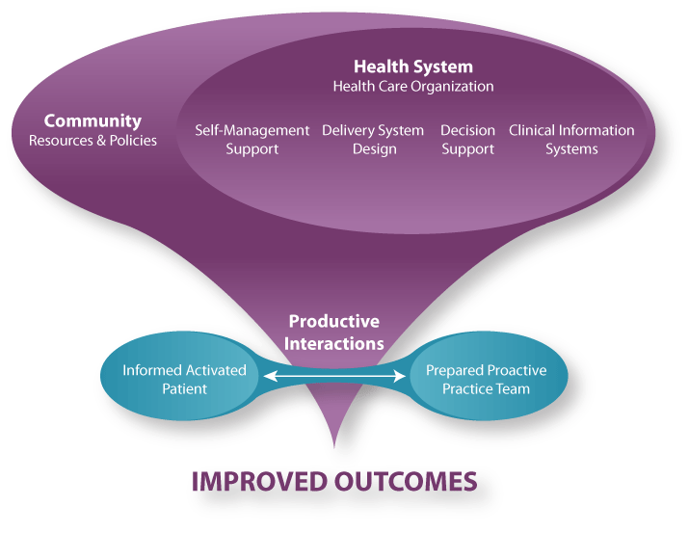
Health care cost-containing measures
1. Incentives and pilots to improve care delivery:
PCCM and ACOs
2. IPAB
3. Payment reforms, e.g., readmission reductions
Center for Health & Pharmaceutical Law & Policy

Slide 4
The Affordable Care Act
and the price of health insurance
Grant support for state rate review processes
Medical Loss Ratio limits
Exchanges to “consider” history of premium increases in approving individual and small group offerings
Federal and state rate review
  § 1003 of ACA added § 2794 to PHSA
  codified at 42USC 300gg-94:
    Ensuring Consumers Get Value for their Dollars
Center for Health & Pharmaceutical Law & Policy

Slide 5
MLR
Federal/New Jersey Differences
Application to large groups
Aggregation
  US: each issuer separately rated
  NJ: aggregates firms with common owners
Computation
  NJ: MLR = claims ÷ premiums
  US: it’s complicated
    Taxes deducted from denominator
    Quality measures added to numerator
  Functional effect: NJ’s 80% generally more stringent than US’s 80%
Center for Health & Pharmaceutical Law & Policy

Slide 6
MLR
New Jersey options
Adopt US model
  The virtue of simplicity, but diminishing NJ goals?
Keep NJ model
  adheres to NJ policy
  But might be preempted, if it would “prevent the application” of the ACA
    For example, did Congress intend to favor quality measures in MLR?
Adopt US model with higher MLR rates
  Approximate current NJ stringency
  Adhere to Federal methodology, policy preferences
Center for Health & Pharmaceutical Law & Policy

Slide 7
Rate Review:
The Federal Framework
What establishes NJ rate review as “effective”?
Receipt of adequate documentation and data
Effective and timely review of the documentation and data
Review of reasonableness of insurers’ assumptions
Center for Health & Pharmaceutical Law & Policy

Slide 8
Rate Review:
The Federal Framework cont’d
Consideration of factors going to components of rate filing, eg,
  Changes by service categories
    Guarding against unfair discrimination within product
      NB: Unlike MLR calculation, rate review is calculated on a product-by-product basis
  Reserve needs, capital, surplus
    Solvency interests
    MLR effects
Center for Health & Pharmaceutical Law & Policy

Slide 9
Rate Review:
The Federal Framework cont’d
Compliance with state law
Transparency requirements
  State agency must make most of filing available on its web site
  State agency must have effective mechanism for receiving public comments on increase application
Center for Health & Pharmaceutical Law & Policy

Slide 10
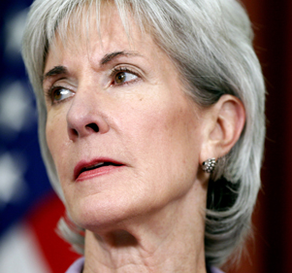
Federal Value Added
Feedback loop with DOBI
To maintain status as “Effective,” must continue to
  Maintain transparency, receptivity to consumer comments
  Perform thorough review of adequate data
  Maintain vigilance against unfair discrimination
Publicity and shaming function
Posting of “excessive” increase filings
Posting of results of review
Publication of “excessive” filings
Center for Health & Pharmaceutical Law & Policy

Slide 11
Questions /comments?
Center for Health & Pharmaceutical Law & Policy

